Slide 1
Examination Cycle Time Management
Personnel Testing Council of Southern California
Luncheon Topic, August 13, 2014
Rod Freudenberg, Ph.D.

Slide 2
The Selection Funnel
Recruitment
Start
Screen Apps
Test
Interview
Cycle Time
Ranking
Final Selection
Verifications
Hire
Finish

Slide 3
Exam Cycle Time: Why does it matter?
The longer a vacancy exists the longer some of the work of the organization is not getting done or is being done by people taking on larger workloads.
Attrition of the strongest candidates because of loss of interest, pursuit of other employment options, negative image of agency.
Analyst exam overload – the exam requests keep coming so the longer it takes, more exams need to be juggled simultaneously (death spiral)

Slide 4
It’s a Process (right to left)

Slide 5
Process Maturity Stages (CMM)
5
Ad-hoc
Defined and Repeatable
Enabled and Instituted
Measured and Predictable
Enhancing
4
3
2
1
Reducing cycle time requires controlling the process.

Slide 6
Outline
Defining the Process
Cycle-Time and Process Efficiency
Cycle-Time Analysis
Cycle Time Management Strategies

Slide 7
Defining the Process: Makes it “Repeatable”

Slide 8
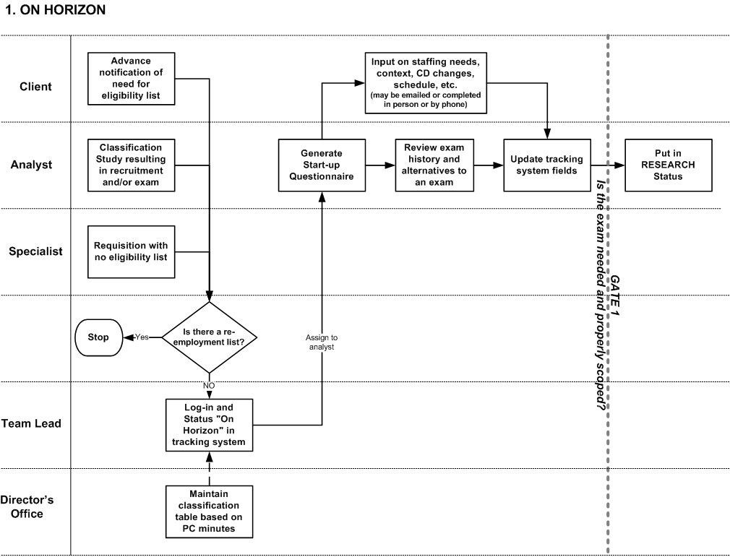
Exam Process Map

Slide 9
Research Phase

Slide 10
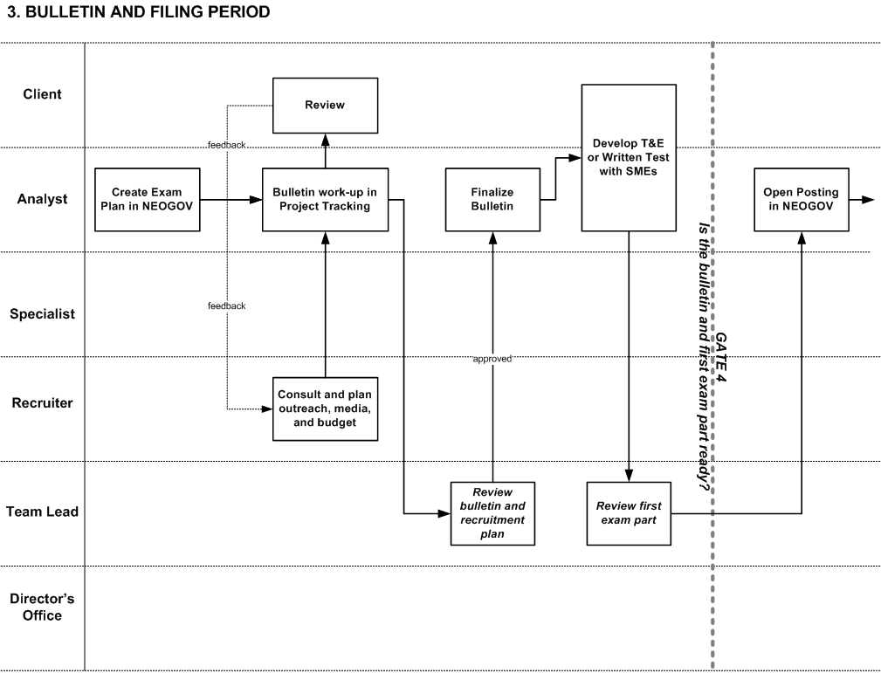
Recruitment Phase

Slide 11
Exam Process

Slide 12
Exam First Part

Slide 13
Scoring First Part

Slide 14
Other Parts

Slide 15
Final Scoring and List

Slide 16
Promulgation and Review

Slide 17
Close-out

Slide 18
Cycle Time Targets What’s the least time it can take?

Slide 19
CYCLE-TIME MANAGEMENT

Slide 20
Exam Cycle Time: What is it?
The amount of time in working days to complete of the process
Broken down to key stages of the process.

Slide 21
Time is a Resource
Resource Requirement = Minimum cycle time to complete one thing TIMES the number of things in process
10 actual work days * 10 exams in process
= 100 total days to complete.
Process Efficiency = Resources Allocated / Resource Requirement
75 days available / 100 days to complete = .75
Actual Cycle time = Resource Requirement / PE
100/75 = 133 days

Slide 22
PE and Work in Process
Given finite resources:
PE
1.00
.75
.50
.25
.05
Exams
1 2 3 4 5 6 7 8 9 10 11 12 13 14 15

Slide 23
Cycle time and Process Efficiency
Reducing Total Cycle Time involves:
Reducing the number of things in process (fewer exams, putting exams in queue)
Increasing process capacity (more staff/resources)
Increase process efficiency
Increasing Process Efficiency involves:
Standardization of materials and procedures
Leveraging technology and automation
Eliminating steps
Eliminating rework
Eliminating false starts
Eliminating wait-states*
Maybe even working harder or faster

Slide 24
Exam Cycle Time Measurement
Mean and Standard Deviation for each exam phase days in process and overall
Prep/Development time
Recruitment time
Exam administration time
Percentage of exams exceeding “control limits” for each phase

Slide 25
Regular Exams Cycle Time Graph (2012-13 actual)
Prep M=22, SD=20!
Recruit PE = .83
Exam PE = 2.08!

Slide 26
Analysis of Variance
Structural: Exam Types
Open, Promotional, Continuous
Entry, Professional, Management, Executive
Complexity (number of exam parts)
Situational: Priority
Urgent, Expedited, Regular, Special
Logistical:
SME time, Raters, Facilities, etc.
Performance:
Individual

Slide 27
Time/Process Analysis
Value-added: Time that is spend directly contributing to the quality of the product
Business Value-added: Time that is required by law or regulation (recruitment, notices, reviews, protests, approvals, documentation, etc.)
Non-Value-added: Everything else!
What can be eliminated? Consolidated? Run concurrently? Automated?
Where can you squeeze out the dead air?

Slide 28
Cycle Time Management
Set baseline for “intervals that matter”
Mean and Standard Deviation
Start-to-Open, Open-to-Close, Close-to-List
Set control limit (CL) for example:
Fixed target (theoretic “ideal”)
One SD >mean
Top 15% outliers
Identify cases that exceed the CL
Elevate attention/intervention for these
Determine root-cause
Get outliers back on track
Systemically address high-leverage root causes

Slide 29
Variability Reduction and Cycle Time Reduction
Statistical Process Control (SPC)

Slide 30
Cycle-Time Management Practices Outlier Review
Track projects weekly – monitor time
Interval times displayed in status reports in Exam Tracking
Escalate when exam exceeds an interval CL (Start-Open, Open-Close, Close-List)
Is there a problem? If so, how can it be addressed?
Follow through
Elevate if challenging or persistent (Director to Director)

Slide 31
Systemic Root Causes Need Systemic Solutions
Transcend Space and Time:
Virtual SME
On-line/electronic, auto-scoring T&Es
Video-based interviews and assessments
Un-proctored Internet Testing (UIT)
Establish partnering relationships at executive levels for rater-sharing (supply-chain management!)
Examination planning template –set reasonable expectations
Testing room, interview room, proctor supply and availability

Slide 32
Cycle-Time Management Practices Consulting Skills
Identifying the “customer(s)”
Scoping and prioritize the project
Setting overall target dates for exam milestones
Clarifying roles, responsibilities, and resources (SMEs and raters)
Asking permission to press for action
Communicating status throughout project – keeping the project visible and urgent
Pressing for action (tough love)

Slide 33
Consulting Skills Exam Start-up (triage)
Priority Options (from start-up)
Urgent: 25 days,
Expedited: 40 days
Regular: 60 days
Unclassified
Priority Implications
Faster exams require more concentrated effort
Faster exams require fewer parts
Faster exams require fewer assembled parts
Faster exams require no wait time
Impact of a poor hire versus impact of unfilled positions?

Slide 34
Consulting Skills Key Levers
Contact requesting manager within one working day of receipt of request
Take lead in creating urgency
Put “in process” only after the exam is prioritized and timeline set
Open recruitment only after first exam part is ready.
“Ready” includes establishing availability of administration and scoring resources for a specific date.
Raters are lined up.
Use “On-hold” status and “Suspended” status (take out of process)
Initiate status discussion with customer at second instance of delay or unavailability
Cancel exam if in suspended status for more than 1 month. Restart when time and resources permit
Reprioritize if customer requirements change
e.g., move from expedited to regular; regular to complex

Slide 35
Organization Climate and Culture
Process improvement and cycle-time management are functions of “employee engagement.”
Involves discretionary effort, creativity, and caring for the product, service, and customer
Involves shared ownership of the data
Must be shared, transparent, credible, and “safe”
Involves shared ownership of goals, problems, and successes

