Slide 1
COMPETENCY
FRAMEWORK
3G
Shirley Chang, Pauline Bourne, & Eric Rowen
Competency Framework 3G is product of the Los Angeles County Office of Education (LACOE) Personnel Commission. Training content modified from
Framework Architect, Dr. Rod Freudenberg.

Slide 2
Outline
Competencies & Competency Modeling
Definition of Competency
Competency Modeling vs. Traditional Job Analysis
The LACOE methodology
Competency Cards
Competency Dictionary (behavior & task levels)
Card Sorting Activity
Competency Modeling Workbook
Weights and Scores

Slide 3
What is a Competency?
A Competency is a work-related behavior, that encompass the strategies, goals, values, and culture of an organization.
Competencies:
Are observable and measurable
Are transferable across a range of occupations
Can either be developed or atrophy

Slide 4
Competencies: This Not That
Competencies are | Competencies are not
Prescriptive of desired behavior | Descriptive of established ways of working
Descriptive of excellence in performance | Descriptive of typical performance
Enablers of organizational change and effectiveness | Maintenance of the status quo

Slide 5
Competency Modeling
Competency modeling is a structured approach to identifying the competencies that enable goal achievement at the following levels:
Organization
Strategic workforce planning
Change management
Job/Role
Performance expectations
Individual
Personal growth
Career development
Performance management

Slide 6
Job Analysis vs. Competency Modeling
Traditional Job Analysis | Competency Modeling
Jobs studied in isolation (Industrial Psychology) | Jobs studied as part of a system and organizational culture (Organizational Development)
Micro-level task-KSA listing (100+) | Macro-level competency selection (10+/-); task and KSA specifics drilled down later as need
Huge linkage matrix (1000 cells) | Manageable matrix (100 cells)
KSAs specifically defined for job | Competencies pre-defined
Low reproducibility | High reproducibility

Slide 7
Competencies: Utility
1. Competency Modeling
2. Exam Development
3. Performance Management
4. Training
The benefits of determining the competency model of a position can extend beyond recruitment purposes:
Competency modeling – The first step is to determine competency model of a position
Exam Development – Chosen competencies then translate into assessment needs
Performance Management – Rating criteria developed can be used for performance management purposes (e.g., performance appraisals, 360 degree feedback)
Training – performance gaps in crucial competencies can determine training needs

Slide 8
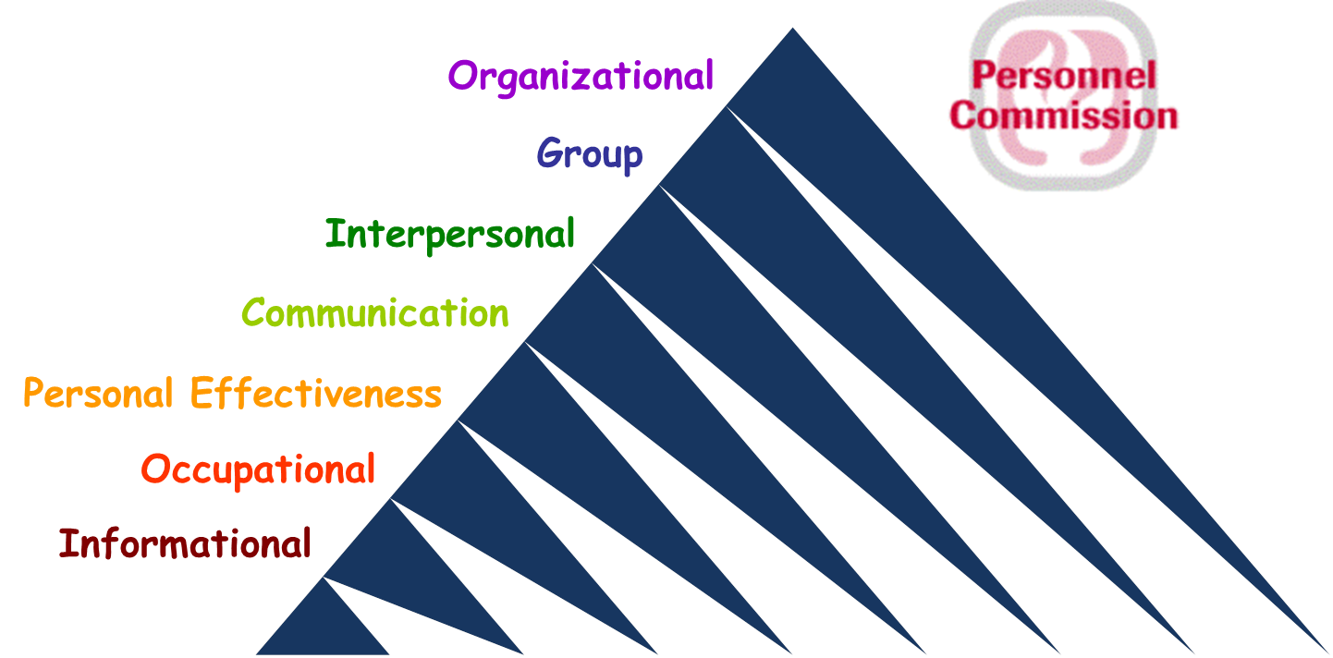
LACOEs Competencies 3G
Pyramid:
Cumulative
Widening scope of impact

Slide 9
7 Groupings, 54 Competencies
INFORMATIONAL: Competencies that enable the use of information, data, or stimuli to make a response suitable to an objective, problem, or situation
OCCUPATIONAL: The knowledge and skills of an occupational group acquired through education, training, and experience
PERSONAL EFFECTIVENESS: Competencies that enable the effective application of one’s skills and abilities
COMMUNICATION: Competencies that facilitate the exchange of information
INTERPERSONAL: Competencies that establish and maintain effective working relationships
GROUP: Competencies that facilitate group effectiveness and contribute to teams and workgroup performance
ORGANIZATIONAL: Competencies that help make whole organizations and systems effective

Slide 10
Competencies: Complete List
Informational (7) Analyzing and Interpreting Data Critical Thinking Decision Making Fact Finding Mathematical Facility Mechanical Insight Reading Comprehension Occupational (9) Design Sense Environmental Exposure Tolerance General Physical Ability Industry Awareness Legal and Regulatory Navigation Manual Dexterity Professional/Technical Expertise Using Technology Safety Focus | Personal Effectiveness (8) Action & Results Focus Adaptability Attention to Detail Handling Stress Innovation Integrity and Ethics Learning Agility Self Management Communication (6) Bilingual Facility Informing Listening Oral Communication Presentation Skill Writing | Interpersonal (7) Customer Focus Handling Conflict Influencing Involving Others Negotiating Professional Impact Relationship Building Group (8) Assessing Talent Delegating Developing Others Group Facilitation Leadership Managing Performance Teamwork Valuing Diversity | Organizational (9) Allocating Resources Leveraging Technology Managing Change Organizational Design Organizational Savvy Org. Systems Thinking Business Process Analysis Project Management Strategic View

Slide 11
Competency Card Structure
Group: Personal Effectiveness
Name: Attention to Detail
Tag: Focusing on the details of work content, work steps, and final work products
Effective: Shows a high level of care and thoroughness in handling the details of the job. Selects critical details to focus on. Checks work to ensure completeness and accuracy. Makes few, if any, errors. Maintains focus and quality under distracting working conditions, high workload, or opportunities to take shortcuts. Detects and addresses errors and omissions in others' work or team projects.
Ineffective: May be careless, making numerous mistakes when working. May not check work before passing it on to others. May be overwhelmed with trivial details. Work may need to be regularly reviewed for accuracy and completeness. May not detect errors, flaws, or omissions in the work of others when reviewing or observing it. May struggle to maintain attention to one's work. May show ridged perfectionism sacrificing timeliness for excessive checking and review.

Slide 12
Competency Levels (in competency dictionary)
Group: Personal Effectiveness
Name: Attention to Detail
Tag: Focusing on the details of work content, work steps, and final work products
Effective: Shows a high level of care and thoroughness in handling the details of the job. Selects critical details to focus on. Checks work to ensure completeness and accuracy. Makes few, if any, errors. Maintains focus and quality under distracting working conditions, high workload, or opportunities to take shortcuts. Detects and addresses errors and omissions in others' work or team projects.
Ineffective: May be careless, making numerous mistakes when working. May not check work before passing it on to others. May be overwhelmed with trivial details. Work may need to be regularly reviewed for accuracy and completeness. May not detect errors, flaws, or omissions in the work of others when reviewing or observing it. May struggle to maintain attention to one's work. May show ridged perfectionism sacrificing timeliness for excessive checking and review.
Behavioral Levels:
Action – Something one does
Instance of the competency
What may be learned, trained, or practiced
Upper levels required mastery of lower levels
Task Levels:
A characteristic of the subject matter, situation or people involved.
What one has to deal with, act upon, or respond to
Span of influence or scope of impact
Job evaluation indicators

Slide 13
Activity: Card Sort
The card sorting activity is a fun, interactive way to begin the conversation with SMEs and capture the needs of the position.
Important Several
(10)
Desirable Many
Critical Few
(5)
Industry Monitoring
Professional & Technical
Decision Making
Attention to Detail
Critical Thinking
Using Technology
Adaptability
Customer Focus
Oral Communication
Presentation Skill
Presentation Skill
Teamwork

Slide 14
Card Sort: Overview
Hands-on
Interactive decision making on competencies
Facilitates discussion and consensus building
Can be completed in one session
Analyst’s role:
Explain the process
Be the SME for the meaning and interpretation of each competency
Facilitate discussion and decision making in selection
Impose constraints (gently) on number and independence

Slide 15
Card Sort: Goals
Goal 1: Parsimony
Fewest number of competencies that cover everything that is important
Minimize redundancy by choosing between “nearest neighbors”
Reduce competencies (lower in the pyramid that are “implicated” in higher pyramid competencies)
Goal 2: Consensus
Consensus must also include analyst

Slide 16
Card Sort: Steps
Step 1: Take out “extra” cards
Step 2: Separate the following cards: Critical Few, Important Several, Desirable Many
Step 3: Instruct the SME to begin going through the cards and pick out those that are needed for successful performance on the job, and sort them in the appropriate categories (Critical, Important, Desirable)
Critical competencies should be those that without possession of that characteristic, one could not perform the duties of the job
As an analyst, start brainstorming how you will test the selected critical and important competencies

Slide 17
Card Sort: Steps (cont.)
Step 4:
Complete competency modeling workbook: 1) rate duties, 1) rate competencies, 2) linkage matrix
See example of completed competency model (excel workbook)

Slide 18
Example: HR Aide
Example of Duties:
Assists in the development of recruitment and examination materials
Assists in the development of recommendation for classification and compensation actions
Gathers information and data using interview, focus group, survey, and observational methods
Gathers archival and published data and information
Compiles, organizes, and codes quantitative and qualitative data
Assists in the analysis of quantitative, qualitative, and statistical data
Prepares summaries of findings and reports containing narrative, table, chart and graphical content

Slide 19
Basic Procedure
Select appropriate Subject Matter Experts
Identify and prioritize the key activities of the job
Identify the most essential competencies
Forced distribution card sort performed by SMEs or Analyst
For each duty, identify competencies that best differentiate performance
Mini-competency model for each duty
Parsimonious set that accounts for the greatest variability job performance. (Constellation rather than full picture)
Mathematically determine weight for each competency as driver of overall job performance

Slide 20
Competency Modeling Path

Slide 21
Weights and Scores
Competency Modeling spreadsheet and Exam Scoring both utilize a Weighted Sum Model (WSM)
Factors are weighted against each other numerically as a percentage of the whole
Relatively simple mathematical calculation for weighing multiple independent criteria
New criteria is created by combining distinct factors
Duty Criticality * Frequency → POJ
POJ * Duty Linkages → Exam Weights
Exam Weights * Rater Input → Candidate Scores

Slide 22
LACOE’s Exam Scoring System
We do NOT have raters assign holistic scores
Focus raters’ attention on specific competencies, limiting bias & outside influence
Point scoring system, with “poison pill” option:
Compelling: Exceptional, above and beyond 4 pts
Strong: Good, relevant responses 3 pts
Moderate: Adequate, needs improvement 2 pts
Limited: Job performance risk, auto-fail 1 pt
Max Score = 4 (100), Min Pass Score = 2 (70), Fail Score = 1.67 (65)

Slide 23
Exam Scoring
Calculating Weighted Sums:
Candidate’s Examination Score = (CmpWt₁)*(CmpScore₁)+(CmpWt₂)*(CmpSc₂)+...
Example Raw Score =
(.15)*(2pts) + (.35)*(3pts) + (.50)*(4pts) = 3.35
Comp 1’s Weight
Comp 2’s Score

Slide 24
Rescaling Exam Scores
Rescale passing scores from a range of 2-4 pts to a range of 70-100 pts
Automatically calculated in NEOGOV
More intuitive to Candidates than percentage
Passing score at 70, Maximum score at 100
, instead of 83.75% (raw percentage)

Slide 25
How LACOE Calculates Scores
In the past, utilizing a weighted sum spreadsheet
Support staff entered weights and individual scores
Potential for errors, timing depends on workload
Now, automatic scoring with The Rater App
Real-time scoring/ranks available
Easily upload scores to NEOGOV
Eliminates copy errors
Dramatically reduces time to send out scores

Slide 26
Benefits of Competency Modeling
Clearly summarizes work behaviors and characteristics essential to job performance
Standardizes process and provides documentation, directly linking job analysis to selection testing
Streamlines process for assigning job-relevant candidate scores in testing, while limiting rater bias

Slide 27
Thank you!
Questions?

